Slide 1



Hand Gesture Recognition Using Deep Learning
Jaypee University of Information Technology, Waknaghat - 173234 (India)
Major Project (18B19CI791) | AY 2023-24
End-Term Presentation (Part - II)
Group No.: 39
Team Member (s)
Kshitiz Bashyal (201306)
Supervisor
Name: Dr Diksha Hooda
Designation: Assistant Professor ( SG )
Department: CSE

Slide 2
Outline
Introduction
Problem Statement
Objectives
Work Done (after Mid-Term Evaluation Part - II)
Project Design
Implementation
Experimental Results and Evaluation
Conclusions and Future Scope
Work Contribution of Each Member
Publications
Supervisor (s) Remarks
References

Slide 3
Introduction
Technological advancements have revolutionized society, especially in computing, reshaping tasks through Human-Computer Interaction (HCI), which seamlessly integrates human abilities with technology, simplifying complex processes.
Gestures, innate to humans, serve as a non-cognitive interface for devices, interpreting commands. This paper explores gesture recognition's wide applications, from virtual reality control to detecting driver drowsiness.
Despite notable advancements, challenges endure, including the cost and inconvenience of glove-based systems. Neural networks, utilizing color segmentation and morphological operations, effectively tackle issues like noise in images. Gestures are applied across diverse fields, spanning entertainment, healthcare, and disaster relief.
The proposed system provides touch-free and remote-free control, improving user experience and offering a practical solution for activities such as watching movies.

Slide 4
Problem Statement
In the evolving field of Human-Computer Interaction (HCI), there's a growing need for quick and intuitive interactions with complex systems. This project addresses this demand by using computer vision and deep learning to enable real-time control of media players through hand gestures.
Gesture recognition offers a natural and instinctive form of communication, yet challenges hinder its seamless integration. Traditional approaches, like glove-based systems, are costly and unwieldy. Furthermore, persistent issues such as noise interference and slow computation restrict the effectiveness of gesture recognition technologies.
The solution utilizes computer vision and Convolutional Neural Networks (CNN) to detect and interpret user hand movements for media player control. A dataset of seven defined gestures trains the CNN model. Integration with PyAutoGUI enables seamless mapping of gestures to keyboard controls, allowing users to interact.

Slide 5
Objectives
Data Collection and Preprocessing - To perform real-world image data collection and implement data preprocessing techniques to enhance the accuracy of the Hand Gesture Recognition Model .
To design and create a Gesture Recognition Model - Design and create a sophisticated Convolutional Neural Network (CNN) model. Utilize the custom-built dataset, encompassing seven precisely defined gestures and to train the model for real-time gesture recognition.
To perform Testing and Validation - Conduct thorough testing and validation procedures on the developed gesture recognition model. Evaluate the model's accuracy, precision, and recall to ensure its reliability and effectiveness in diverse scenarios.
To develop User Interface for operational convenience – Develop a Web interface to use the gesture recognition model .

Slide 6
Work Done (after Mid-Term Evaluation Part - II)
Finalised the CNN Model Architecture for gesture recognition.
Collected more images to increase the volume of the data set .
Evaluated the performance of the CNN Model using metrics like accuracy , precision and recall .
Documented the findings in the report .
Deployed the web app on streamlit.
Improved the real time testing of the model by configuring the correct camera distance , lighting condition and background .

Slide 7
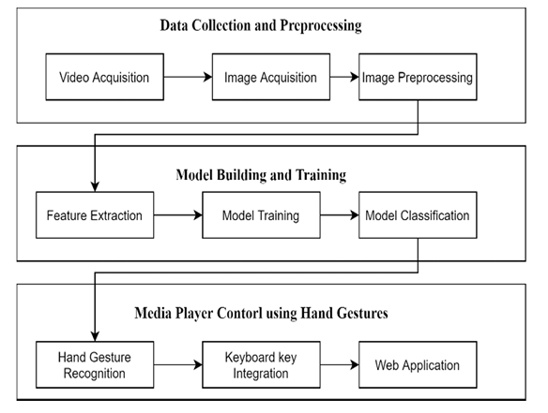
Project Design
Gesture Recognition System involves data acquisition, data pre-processing, feature extraction and finally classification for the sake of having an immersive and interactive system.

Slide 8
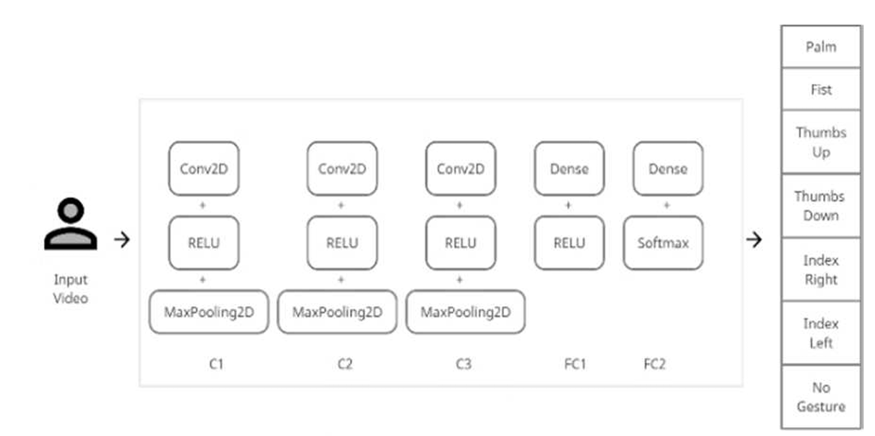
Project Design (cont…)
The CNN model is trained by feeding the image frames to three convolution layers with a ReLU activation function. Pooling layers are added to perform max pooling which is then flattened and added to dense layers as shown in Fig (b).
Fig (b)

Slide 9
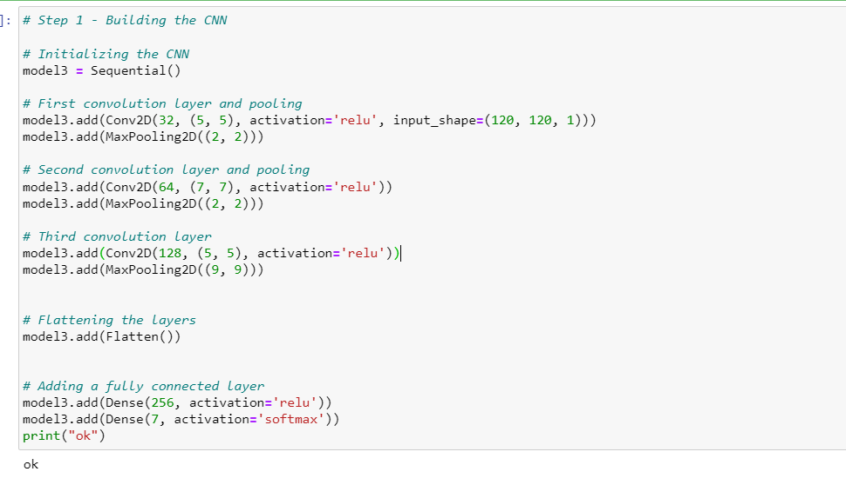
Implementation
Model architecture

Slide 10
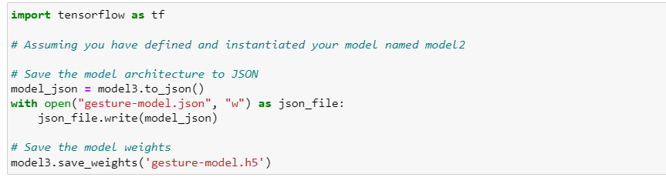
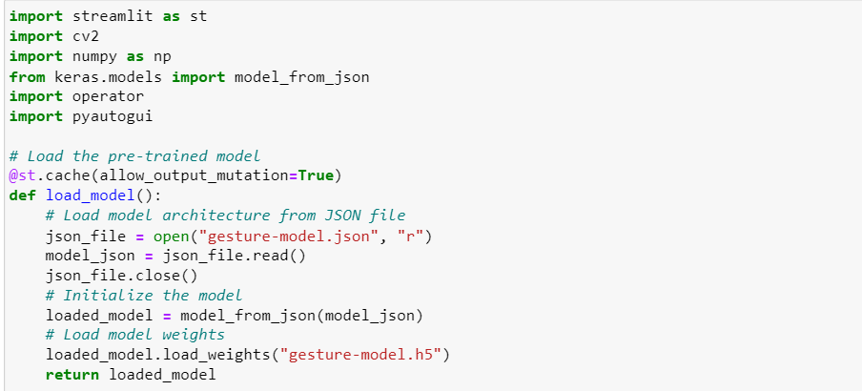
Implementation (cont…)
Saving architecture to JSON and weights to HDF5
Real-Time Gesture Recognition and Streamlit Integration

Slide 11
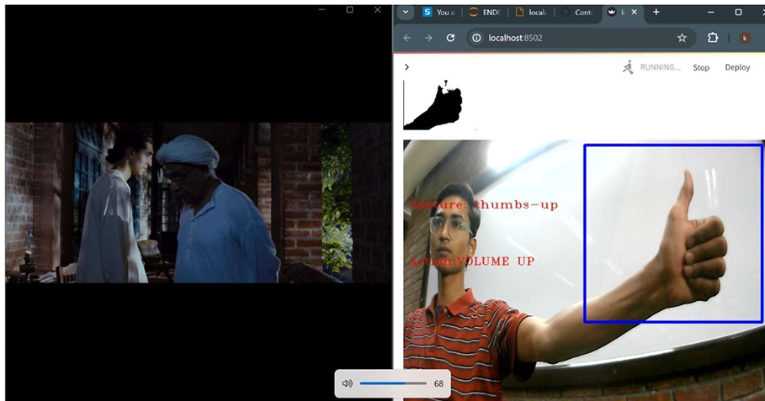
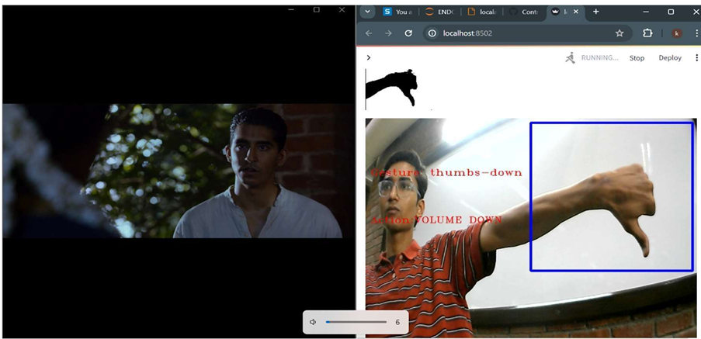
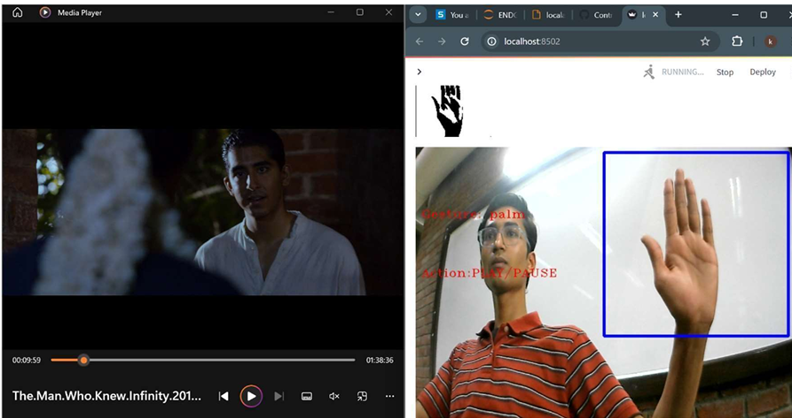
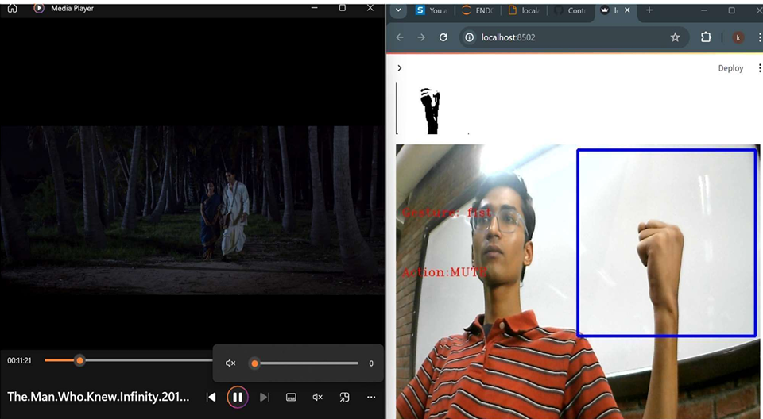
Implementation (cont…)

Slide 12
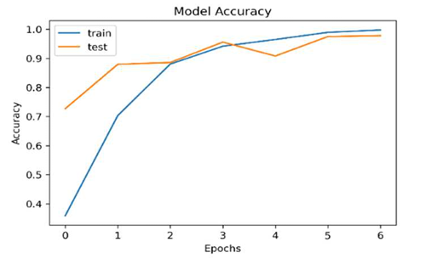
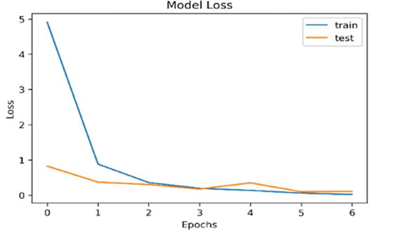
Experimental Results and Evaluation
The figure below Shows the comparison of the loss of both train and test sets of the third model of CNN.
The convergence of the graphs concludes that the model can be used for prediction and has no overfitting or underfitting issues.

Slide 13
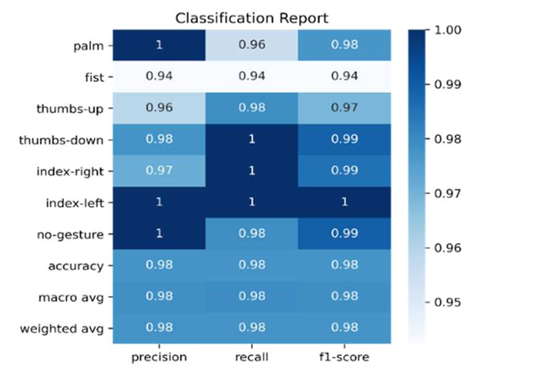
Experimental Results and Evaluation (cont…)
The performance of the CNN model is also evaluated using different performance metrics such as precision, recall, and f1-score and displayed using the classification report.
Model showed 97.7% testing accuracy and misclass of only 2% on the custom dataset.

Slide 14
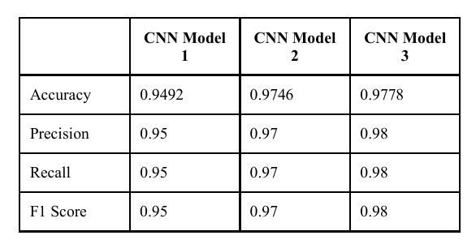
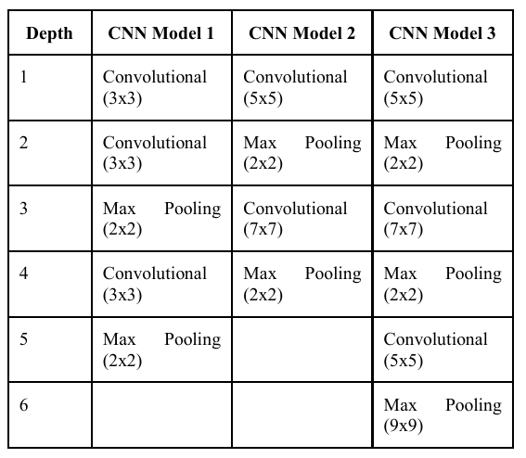
Experimental Results and Evaluation (cont…)
3 unique architectures are created to inspect the effectiveness and assess the best model based on accuracy.

Slide 15
Conclusions and Future Scope
The OpenCV techniques are used to capture the images, 2 Dimensional Convolutional Neural Network is used to extract features and predict the gestures, PyAutoGUI is used to control the keyboard keys whenever a gesture is integrated with it is predicted
The proposed CNN model achieved a high accuracy of 98%, providing a user-friendly, cost-effective approach to interaction with computer systems. Thus, the proposed system is a true real-time model with low to negligible latency.
The future scope is to work on improving the gesture recognition capabilities in varied environments such as illumination levels. Also, the integration of more functions is proposed with new hand gestures to use with other applications such as typing in word documents and web browsers.

Slide 16
Publications
Use one slide to list any publication (s).

Slide 17
Work Contribution of Each Member
S. No. | University Roll No. | Work Done | Individual Contribution (%)
1. | 201306 | Collected the images for data set Training and testing of CNN model Documentation | 100 %

Slide 18
Supervisor (s) Remarks
S. No. | Supervisor | Remarks (as mentioned in Weekly Log)
1. |  | Remark 1 Remark 2 Remark 3 Remark 4 Remark 5

Slide 19
References
[1] Zhuang H, Yang M, Cui Z, Zheng Q. A method for static hand gesture recognition based on non-negative matrix factorization and compressive sensing. IAENG International Journal of Computer Science. 2017 Mar 1;44(1):52-9.
[2] Paul PK, Kumar A, Ghosh M. Human-Computer Interaction and its Types: A Types. International Conference on Advancements in Computer Applications and Software Engineering (CASE 2012), At Chittorgarh, India. –2012 2012 Dec 21.
[3] Ritupriya G.Andurkar, Human–computer interaction. International Research Journal of Engineering and Technology, (ISSN: 2395-0072 (P), 2395-0056 (O)). 2015; 2(6):744-72.
[4] Shanthakumar VA, Peng C, Hansberger J, Cao L, Meacham S, Blakely V. Design and evaluation of a hand gesture recognition approach for real-time interactions. Multimedia Tools and Applications. 2020 Feb 21:1-24. [5] Bashir A, Malik F, Haider F, Ehatisham-ul-Haq M, Raheel A, Arsalan A. A smart sensor-based gesture recognition system for media player control. In2020 3rd International Conference on Computing, Mathematics and Engineering Technologies (iCoMET) 2020 Jan 29 (pp. 1-6). IEEE
[6] Gope DC. Hand Gesture Interaction with Human-Computer. Global Journal of Computer Science and Technology. 2012 Feb 10.

Slide 20
References (cont…)
[7] Zhao L. Gesture Control Technology: An investigation on the potential use in Higher Education. University of Birmingham, IT Innovation Centre: Birmingham, UK. 2016 Mar.
[8] Harshada Naroliya, Tanvi Desai, Shreeya Acharya, Varsha Sakpal Enhanced Look Based Media Player with Hand Gesture Recognition. International Research Journal of Engineering and Technology, (ISSN: 2395-0072 (P), 2395- 0056 (O)).2018;5(3): 2032-35.
[9] Wachs JP, Kölsch M, Stern H, Edan Y. Vision-based handgesture applications. 49
[10] Yashas J, Shivakumar G. Hand Gesture Recognition: A Survey. In2019 International Conference on Applied Machine Learning (ICAML) 2019 May 25 (pp. 3- 8). IEEE.
[11] Sharma P, Sharma N. Gesture Recognition System. In2019 4th International Conference on Internet of Things: Smart Innovation and Usages (IoT-SIU) 2019 Apr 18 (pp. 1-3). IEEE.
[12] Hakim NL, Shih TK, Kasthuri Arachchi SP, Aditya W, Chen YC, Lin CY. Dynamic hand gesture recognition using 3DCNN and LSTM with FSM context-aware model. Sensors. 2019 Jan;19(24):5429.

Slide 21
References (cont…)
Provide a comprehensive list of at least 25 references in IEEE format

Slide 22
Thanks.

